Slide 1
Asset Management Overview …
Notes:
Developed November 2015

Slide 2
What is Asset Management?
Answers:
What do we own?
What is it worth?
Where is it?
What kind of shape is it in?
What are the maintenance/operational costs?
When do we need a new one?
Allows for informed decision making.
Ultimate goal: Sustainable Service Delivery!
Notes:
Definition of Asset Management:
“The combination of management, financial, economic, engineering and other practices applied to physical assets with the objective of providing the required level of service in the most cost-effective manner.”

Slide 3
Why Practice Asset Management?
Identify costs
Balance service delivery with community’s willingness to pay
Notes:
Identify the costs to provide, maintain, renew, and if necessary, eliminate community owned capital assets.
Consider full lifecycle costs, not just capital costs
Balance service delivery with community members’ willingness to pay.

Slide 4
Asset Management is a Team Sport
Key Staff: CAO/Executive Director,
Finance, Operations
Council
Community!

Slide 5
Benefit of Communication with Residents
Improve level of trust between residents and their municipal / First Nation government
Understand the roles, responsibilities and limitations of local government
Capacity to participate in conversations involving community owned assets

Slide 6
Three Initiatives for the year ahead…
Asset Management Conference
Funding Agreements
Community of Practice

Slide 7
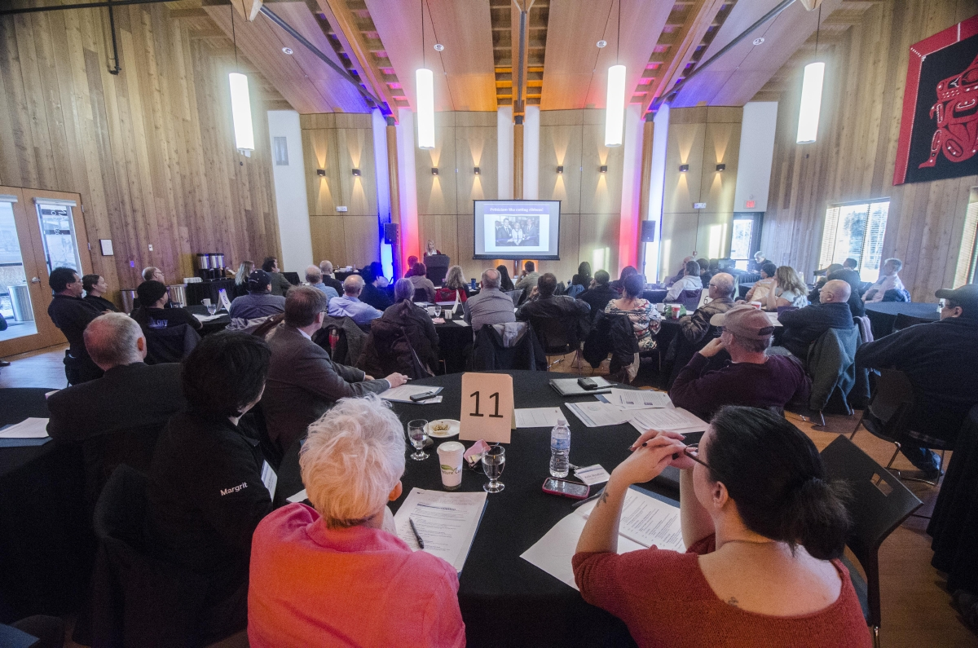
Asset Management Conference
Notes:
November 5 & 6, 2015
All Yukon municipalities and First Nation governments were invited to learn about asset management approaches, hear stories from experienced practitioners, learn how to access funding from the Government of Yukon and join the new Yukon Asset Management Community of Practice.
The intent of the conference was to:
Provide an overview of asset management concepts and processes
Discuss approaches and common challenges
Learn from experts and experienced practitioners
Highlight available funding options for Yukon First Nation and municipal governments
Discuss the asset management pilot project that took place with the Teslin Tlingit Council and Village of Teslin
Initiate a Yukon Asset Management Community of Practice
November 5-6, 2015
All municipalities and First Nations were invited. Nearly all attended.
Municipalities and First Nations were able to connect with one another and share stories, experiences and expertise
The Government of Yukon explained its plan to provide project funding and initiate/fund an asset management community of practice.

Slide 8
Funding Program
Transfer Payment Agreements
Application information online now
All Yukon municipalities and First Nations may apply.
Up to $40,000 each.
Communities can tailor activities to their specific needs.
Notes:
Visit: www.community.gov.yk.ca/community_affairs/asset_mgmt.html

Slide 9
How to Apply
Completed application form;
Completed AssetSMART self-assessment;
A letter of support from Council indicating organizational commitment to asset management implementation.

Slide 10
Funding Process
$10,000 advance upon approval of application
Additional $30,000 available for reimbursement
Spending must be between April 1, 2015 to December 31, 2016.
Applications due February 1, 2016
Final reports due January 31, 2017

Slide 11
Gas Tax Funding
Eligible Project Category - #18 Capacity Building
Eligible Expenditures include: life-cycle cost assessments and asset management plans
A) studies, strategies or systems related to asset management
B) training directly related to asset management planning
Municipalities & First Nations will need to report on the progress they are making towards Asset Management planning.
Reports are due to the Yukon government by December 31, 2017

Slide 12
Community of Practice
A group of people who come together around shared knowledge or goals – Asset Management
A way to share knowledge and develop skills
We will plan to meet Quarterly, either physically or virtually.
Notes:
The community of Practice is our way of providing ongoing support for our stakeholders beyond the conference and funding.
It is through this that we will all continue the learning and the sharing of experiences that began at the November 2015 conference.
For our Municipal and First Nation Stakeholders - We will fund travel and accommodation for quarterly gatherings of Asset Management Practitioners.
Meetings can be in person or virtual. We will try to meet once or twice somewhere other than Whitehorse.

Slide 13
Community of Practice
Each meeting will feature a specific learning objectives
First Meeting in January 2016 – Focused on establishing structure and priorities of group
Develop a Yukon Framework, or Best Practices document
Notes:
Each meeting of the Community of Practice will feature a specific learning objective.
The First meeting will be held in January 2016.
At the First Meeting we will establish the structure and priorities of the group. This will help determine the best way the Yukon government can support municipalities and First Nations as they work to implement asset management practices.
Beyond the First meeting, we have not set any agenda. We will look to the participants, the members of the community of practice to decide what needs to be learned or discussed.
Ultimately, we want the group to work towards a common framework, or best practices document. This document will ensure that the learnings of the group are carried forward and documented.

Slide 14
A Culture of Asset Management…
The idea is to enable a culture of Asset Management
Support communities as they develop their own solutions, but work together to build a common framework or best practices
Knowledge development & information sharing! Learn from each other!
Successful Asset Management is not one size fits all!

Slide 15
Thanks!

